Slide 1
Node.js Express
by Yaroslav Vendysh

Slide 2
General information
Express - fast, unopinionated, minimalist web framework for Node.js
Command to install - npm install express --save
Current version - 4.17.1
Beta version - 5.0.0

Slide 3

Route
Routing refers to how an application’s endpoints (URIs) respond to client requests.
Route definition takes the following structure:
Where:
app is an instance of express.
method is an HTTP request method, in lowercase.
path is a path on the server.
handler is the function executed when the route is matched.

Slide 4




Route methods
A route method is derived from one of the HTTP methods, and is attached to an instance of the express class. The following code is an example of routes that are defined for the GET, POST, PUT, DELETE methods to the root of the app.

Slide 5
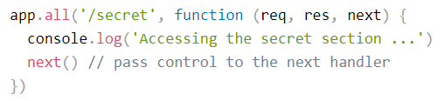
Route methods
There is a special routing method, app.all(), used to load middleware functions at a path for all HTTP request methods. For example, the following handler is executed for requests to the route “/secret” whether using GET, POST, PUT, DELETE, or any other.

Slide 6




Route paths
Route paths, in combination with a request method, define the endpoints at which requests can be made. Route paths can be strings, string patterns, or regular expressions. The characters ?, +, *, and () are subsets of their regular expression counterparts.

Slide 7




Route parameters
Route parameters are named URL segments that are used to capture the values specified at their position in the URL. The captured values are populated in the req.params object, with the name of the route parameter specified in the path as their respective keys.

Slide 8

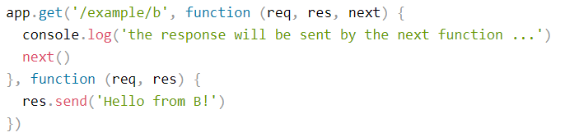
Route handlers
You can provide multiple callback functions that behave like middleware to handle a request. The only exception is that these callbacks might invoke next('route') to bypass the remaining route callbacks.

Slide 9
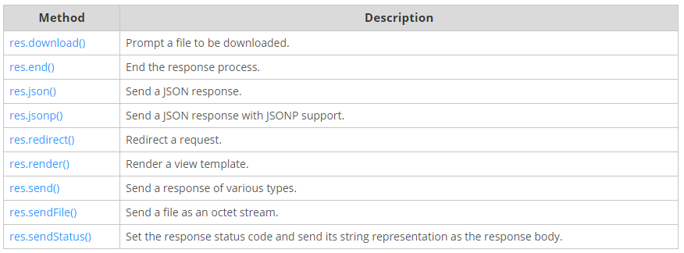
Route response methods
The methods on the response object (res) in the following table can send a response to the client, and terminate the request-response cycle. If none of these methods are called from a route handler, the client request will be left hanging.

Slide 10
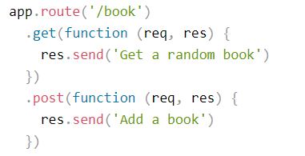
Route app.route()
You can create chainable route handlers for a route path by using app.route(). Because the path is specified at a single location, creating modular routes is helpful, as is reducing redundancy and typos.

Slide 11

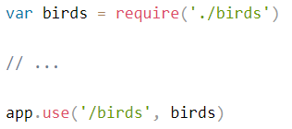


Route express.Router
Use the express.Router class to create modular, mountable route handlers. A Router instance is a complete middleware and routing system; for this reason, it is often referred to as a “mini-app”.

Slide 12
Middleware
Middleware functions are functions that have access to the request object (req), the response object (res), and the next function in the application’s request-response cycle.
Middleware functions can perform the following tasks:
execute any code
make changes to the request and the response objects
end the request-response cycle
call the next middleware in the stack

Slide 13
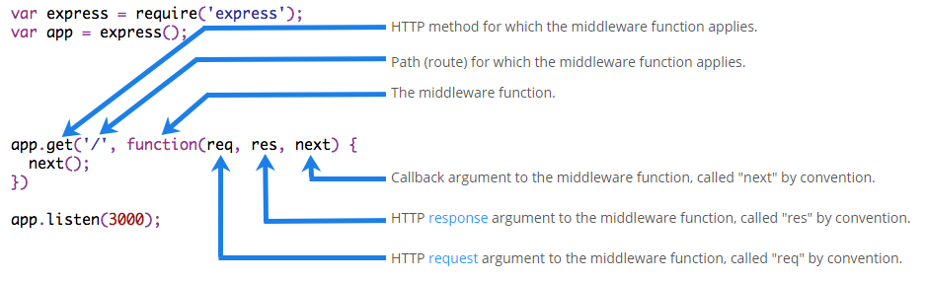
Middleware syntax
The following figure shows the elements of a middleware function call:

Slide 14
Middleware using
Express is a routing and middleware web framework that has minimal functionality of its own: an Express application is essentially a series of middleware function calls.
An Express application can use the following types of middleware:
application-level middleware
router-level middleware
error-handling middleware
built-in middleware
third-party middleware

Slide 15
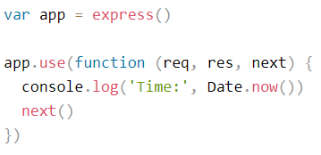
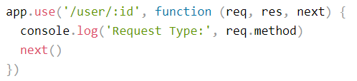
Middleware application-level
Bind application-level middleware to an instance of the app object by using the app.use() and app.METHOD() functions, where METHOD is the HTTP method of the request that the middleware function handles in lowercase.

Slide 16
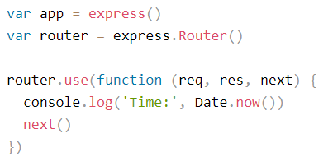
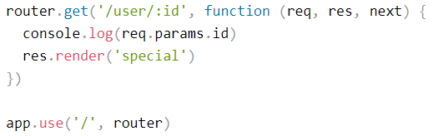
Middleware router-level
Router-level middleware works in the same way as application-level middleware, except it is bound to an instance of express.Router(). Load router-level middleware by using the router.use() and router.METHOD() functions.

Slide 17
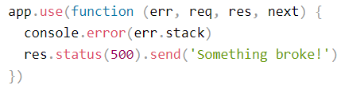
Middleware error-handling
Define error-handling middleware functions in the same way as other middleware functions, except with four arguments instead of three, specifically with the signature (err, req, res, next)).

Slide 18
Middleware built-in
Starting with version 4.x, Express no longer depends on Connect. The middleware functions that were previously included with Express are now in separate modules.
Express has the following built-in middleware functions:
express.static serves static assets such as HTML files, images, and so on.
express.json parses incoming requests with JSON payloads.
express.urlencoded parses incoming requests with URL-encoded payloads.
NOTE: express.json and express.urlencoded are available with Express 4.16.0+

Slide 19
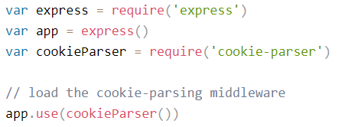
Middleware third-party
Use third-party middleware to add functionality to Express apps. Install the Node.js module for the required functionality, then load it in your app at the application level or at the router level.

Slide 20
Template engines
A template engine enables you to use static template files in your application.
At runtime, the template engine replaces variables in a template file with actual values, and transforms the template into an HTML file sent to the client. This approach makes it easier to design an HTML page.
Some popular template engines that work with Express are Pug, Mustache, and EJS.

Slide 21
Template engines setting
To render template files, set the following application setting properties, set in app.js in the default app created by the generator:
views, the directory where the template files are located:
app.set('views', './views')
view engine, the template engine to use. For example, to use the Pug template engine:
app.set('view engine', 'pug').
Notes:
Местаж

Slide 22
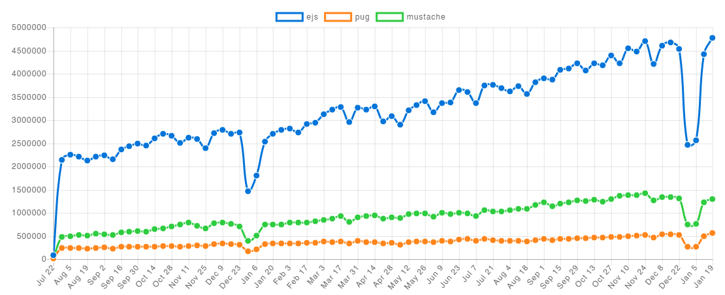
Template engines comparison
Notes:
Местаж

Slide 23
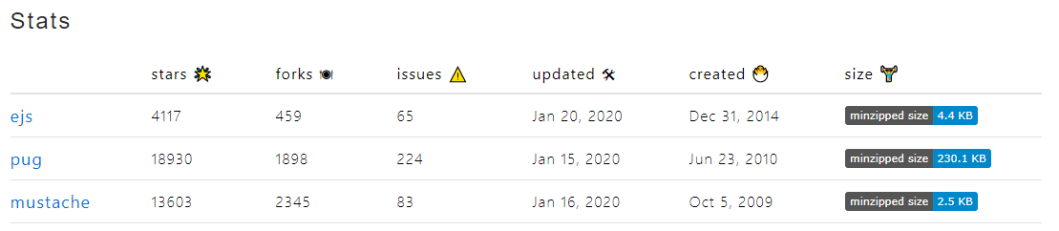
Template engines comparison
Notes:
Местаж

Slide 24
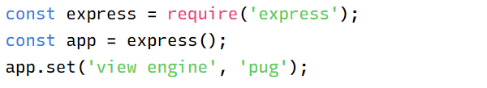
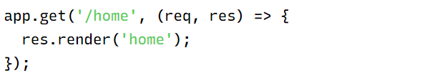

Template engines Pug

Slide 25
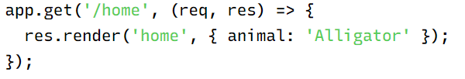

Template engines Pug

Slide 26
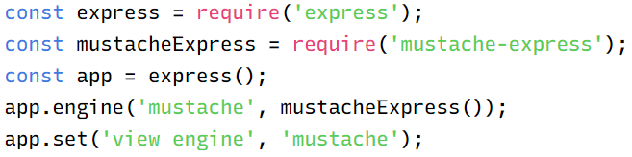
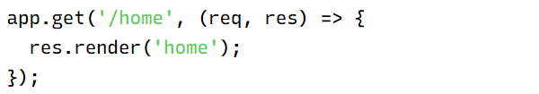

Template engines Mustache

Slide 27
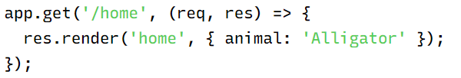

Template engines Mustache

Slide 28

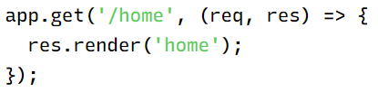

Template engines EJS

Slide 29
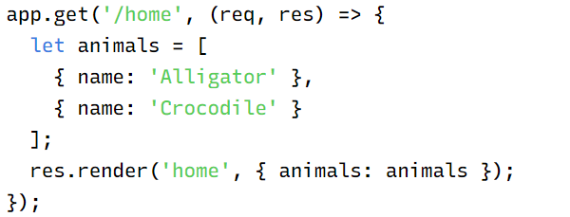
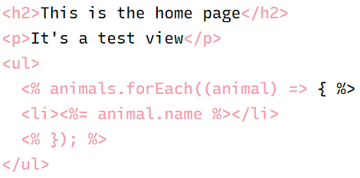
Template engines EJS

Slide 30
Сonclusion
EXPRESS.JS
Routes
Middlewares
Template engines
GET
POST
PUT
DELETE
ALL
application-level
router-level
error-handling
built-in
third-party
Pug
Mustache
EJS

Slide 31
Reference list
http://expressjs.com/
https://www.tutorialspoint.com/nodejs/nodejs_express_framework.htm
https://www.guru99.com/node-js-express.html
https://developer.mozilla.org/en-US/docs/Learn/Server-side/Express_Nodejs
https://pugjs.org/api/getting-started.html
https://ejs.co/
https://mustache.github.io/

Slide 32
Thank you for attention
by Yaroslav Vendysh

